Slide 1
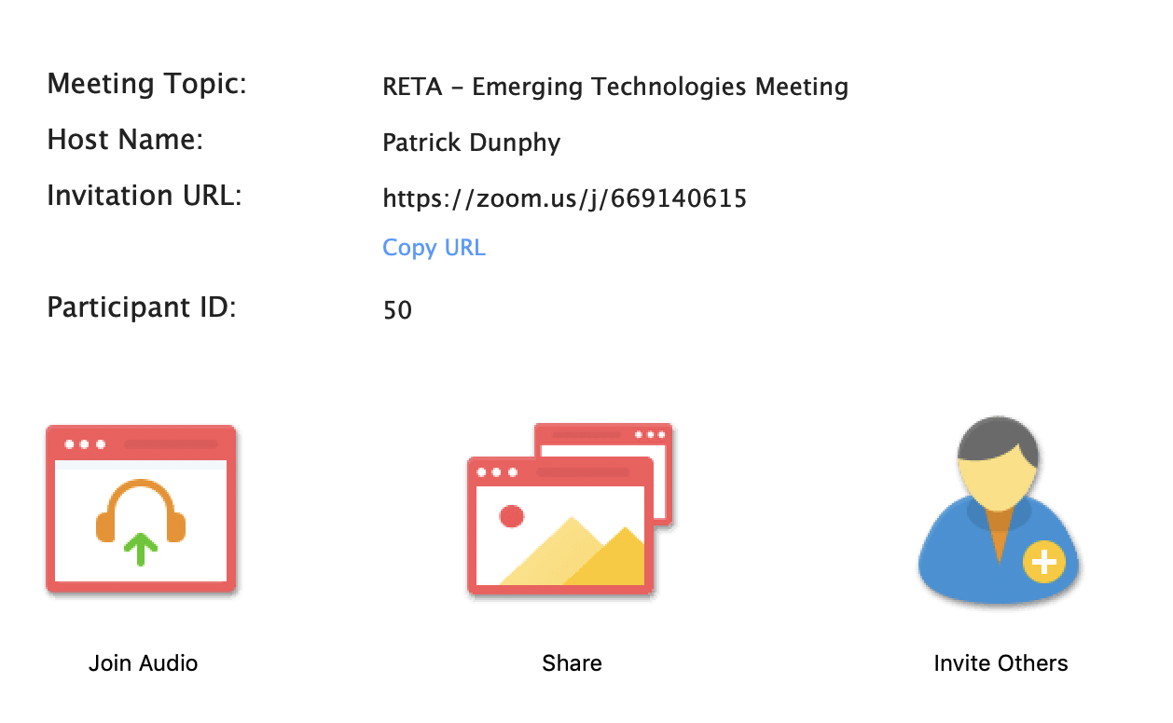
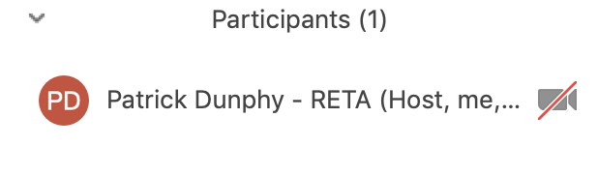
WELCOME – Please setup Zoom
Please update your Zoom name by hovering over your name and selecting RENAME
Follow the format [FIRST NAME] [LAST NAME] – [Company]
If you have also dialed in by phone, dial your Participant ID into your phone #??#

Slide 2

Resident Screening Workgroup
27 August 2020

Slide 3

Code of Conduct
No discussion of rates, charges or other monetary considerations
No disparaging remarks about any company, supplier, person or entity
No allocation of customers
No refusal to deal with a supplier or class of suppliers
Antitrust law applies
Be careful of video
Try to use raise hand functionality wherever possible

Slide 4

Agenda
Code of Conduct
Introductions (if necessary)
Leadership & nominations reminder
Mission & plan review
Discuss next steps
Other items as necessary

Slide 5


Resident Screening Leadership
Kelly Myers
Director of Ancillary and Procurement Roscoe Property Management
Nikki Paepule
Director, Receivables & Screening Departments - Greystar

Slide 6
In addition to yourself, we are looking for…
Operators with screening experience
Identity & multifamily fraud experts
Screening system technology providers
Identity verification services
Resident applications systems
New data sources for identity verification

Slide 7
Mission
The real estate industry needs new ways to manage and mitigate customer risk given the rapidly evolving regulatory space that varies widely between jurisdictions. Meanwhile, privacy regulations are making it difficult and expensive to aggregate an accurate risk model for each potential resident, despite new analytics, payment models and methods for measuring risk across real estate company customers. The group will create a resident risk evaluation best practices and data integration standards that reflects modern tools, data, regulatory requirements, property and applicant types, and other best practices to ensure that properties have an accurate model for each and every potential customer. This will reduce fraud and increase on-time payments for many properties.

Slide 8
Outcomes
Resident Risk Evaluation Framework
Data Models and Standards that Support Resident Screening & Reduced Fraud

Slide 9
Risk, Fraud, Compliance
Identity
Address
Employment
Synthetic
Application
Income
Criminal records
Fair housing
Evictions
Late payments
Return scoring

Slide 10
Let’s get started
What are key sources of fraud in resident screening?
What are symptoms of fraud in the screening process?
What new systems or data is available to prevent fraud?
What property operations will prevent or reduce fraud?

